Slide 1
Making Blockchain Real for Business Explained
V2.14 15 Mar 16
https://ibm.box.com/BlockExp
Notes:
Thanks, pleasure etc.
There is much hype around Blockchain.
Most of this relates to the use of Blockchain to underpin the Bitcoin crypto currency.
Whilst IBM are not interested in Crypto currency, we are very interested in exploring the broader business application of Blockchain technology. This is a transformational opportunity for many of our clients
This touches most all industries – we are making Blockchain REAL for business.

Slide 2
Contents
What
. . are Blockchain technologies ?
Why
. . is it relevant for our business?
How
. . can IBM help us apply Blockchain?
Notes:
Presentation is in three sections addressing the “big” questions for business use of Blockchain.
First section we will give CONTEXT for Blockchain by looking at the BUSINESS NETWORK and how to make this relevant for the 21st Century.
Then consider benefits and use cases for industrial Blockchain.
Finally focus on practical steps to make this new technology real for business.

Slide 3
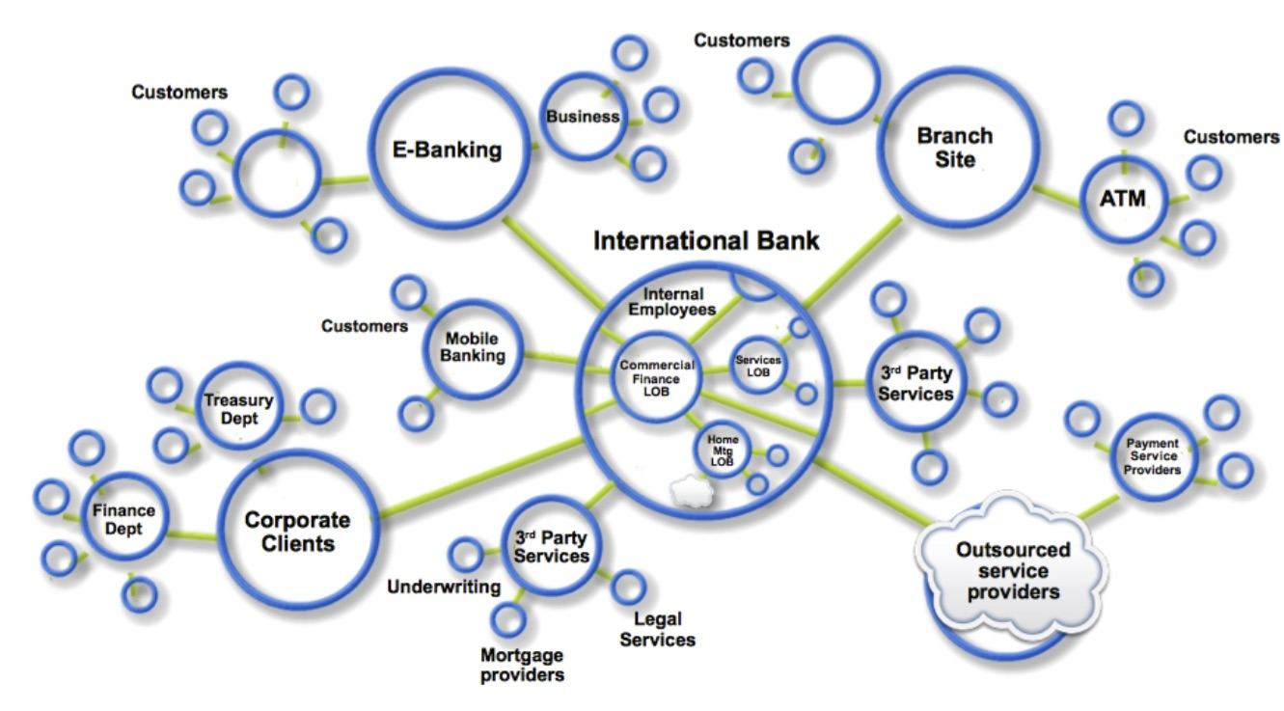
Business Networks, Markets & Wealth
What?
Business Networks benefit from connectivity
Participants are customers, suppliers, banks, partners
Cross geography & regulatory boundary
Wealth is generated by the flow of goods & services across business network
Markets are central to this process:
Public (fruit market, car auction), or
Private (supply chain financing, bonds)
Notes:
Business never operates in isolation. They are participants in a business network.
Business Networks will connect customers, suppliers, banks and regulators and will cross geographical boundaries.
WEALTH is generated as goods and services move across this network; this flow is referred to as a MARKET.
Growth of wealth can be constrained if the network is heavily silo’d or inefficient.

Slide 4
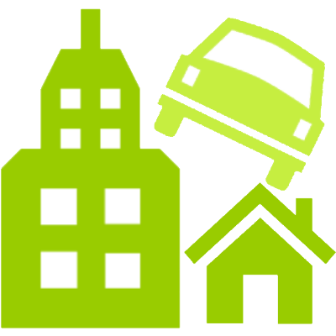
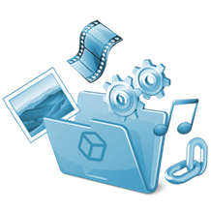
Transferring Assets, building Value
What?
Anything that is capable of being owned or controlled to produce value, is an asset
Two fundamental types of asset
Tangible, e.g. a house
Intangible e.g. a mortgage
Intangible assets subdivide
Financial, e.g. bond
Intellectual e.g. patents
Digital e.g. music
Cash is also an asset
Has property of anonymity
Notes:
Ownership of assets pass across the network in return for payments, and governed by contracts.
ASSETS can be tangible and intangible, We are most comfortable with tangible (Cars, Houses),
INTANGIBLE assets – financial instruments most obvious, but don’t forget about intellectual assets like patents and growing digital assets (music, games, video, art).

Slide 5
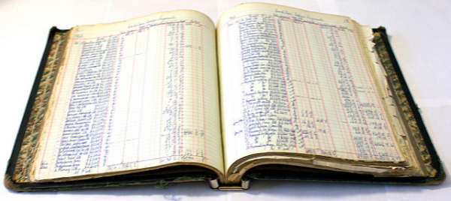
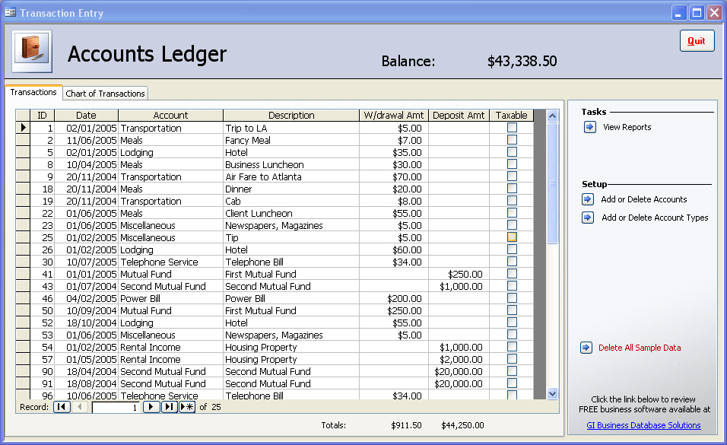
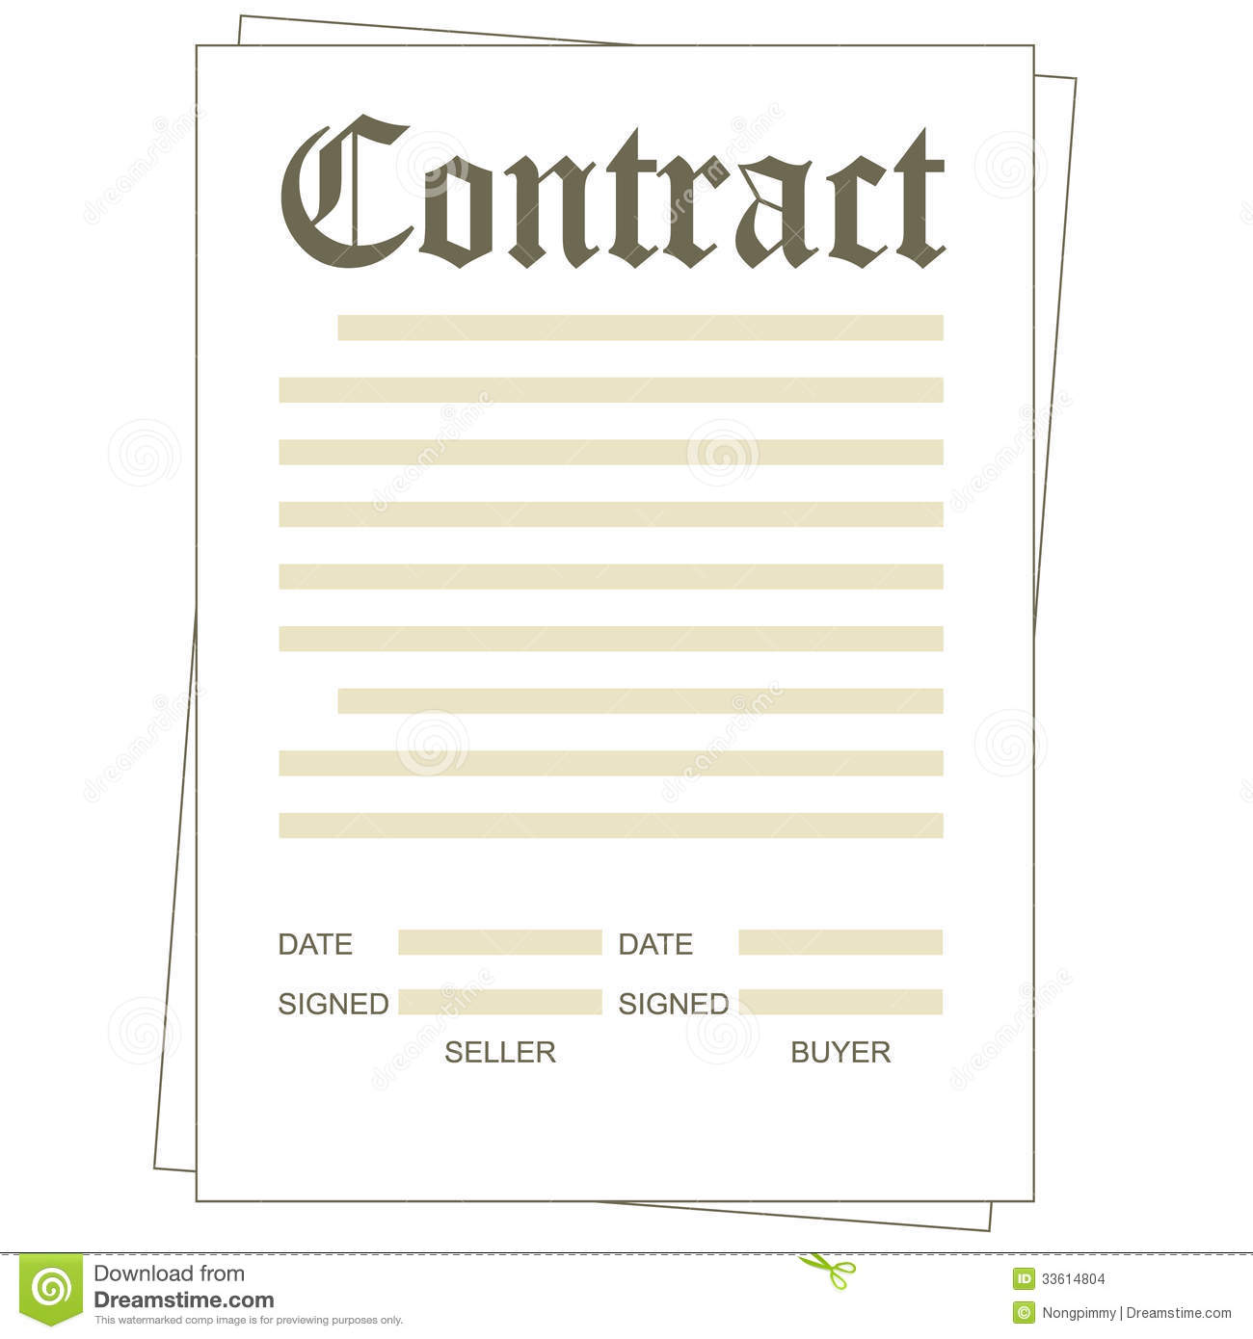
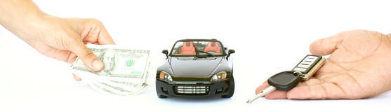
Ledgers are key . . .
What?
Ledger is THE system of record for a business
Business will have multiple ledgers for multiple business networks in which they participate.
Transaction - an asset transfer onto of off the ledger
John gives a car to Anthony (simple)
Contract - conditions for transaction to occur
If Anthony pays John money, then car passes from John to Anthony (simple)
If car won't start, funds do not pass to John (as decided by third party arbitrator) (more complex)
Notes:
Ledgers are not new – they have been used for double entry book keeping since the 13th Century
Commercial usage of the term is for the "principal book of account" in a business house.
THE system of record for recording asset transfer in and out of a business.

Slide 6
Introducing Blockchain
What?
A shared ledger technology allowing any participant in the business network to see THE system of record (ledger)
Notes:
What’s new e here is the SHARED LEDGER – up to this point each participant had their own Ledger
This sharing is the foundation for innovative business solutions,
This introduces an interesting set of technical challenges, including (1) participant identity and privacy & (2) transaction privacy
Let’s look at this in some more detail.

Slide 7





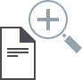
Problem - Difficult to monitor asset ownership and transfers in a trusted business network
What?
Ledger
Party A’s Records
Incident
Ledger
Ledger
Counter-party
records
Bank records
API-integrations
Party C’s Records
Auditor records
Ledger
Party B Records
Ledger
Ledger
Inefficient, expensive, vulnerable
Notes:
This is the “BEFORE” picture representing the “status quo” for business networks.
Each participant keeps their own ledger(s) which are updated to represent business transactions as they occur.
This is EXPENSIVE due to duplication of effort and intermediaries adding margin for services.
It is clearly INEFFICIENT, as the business conditions – the contract – is duplicated by every network participant
It is also VULNERABLE because if a central system(e.g. Bank) is compromised due to an incidents this affects the whole business network. Incidents can include fraud, cyber attack or a simple mistake.

Slide 8
Solution – shared, replicated, permissioned ledger
What?
Party A’s Records
Counter-party
records
Ledger
Ledger
Bank records
Ledger
Party C’s Records
Auditor records
Ledger
Ledger
Ledger
Party B Records
Participants have multiple shared ledgers
NOTE : Participants same as before
Consensus, provenance, immutability, finality
Notes:
The novel Blockchain architecture give participants the ability to share a ledger which is updated every time a transaction occurs through peer to peer replication.
Cryptography is used to ensure that network participants see only the parts of the ledger that are relevant to them, and that transactions are secure, authenticated and verifiable.
Blockchain also allows the contract for asset transfer to be embedded in the transaction database determining the conditions under which the transaction can occur.
Network participants agree how transactions are verified through consensus or similar mechanisms. Government oversight, compliance & audit can be part of the same network.
Participants SAME AS BEFORE – this is not a disintermediation play
CONSENSUS– means all participants agree that a transaction is valid
PROVENANCE– means participants know where the asset came from and how it’s ownership has changed over time
IMMUTABILITY– means no participant can tamper with a transaction once it’s agreed. If a transaction was in error then a NEW transaction must be used to reverse the error, with both visible
FINALITY– means that there is ONE place to determine the ownership of an asset or completion of a transaction. This is the role of the SHARED LEDGER.

Slide 9

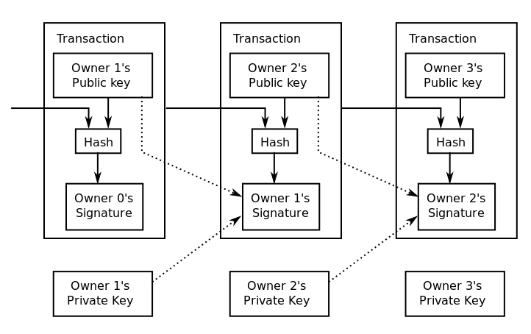
Blockchain underpins Bitcoin . . .
What?
bitcoin: unregulated, censorship-resistant shadow currency
bitcoin: first Blockchain application
pioneer of Blockchain technology
BUT Blockchain is not bitcoin
Digital currencies different from cryptocurrency
Notes:
Blockchain technology enables the Bitcoin crypto currency and is best known for this usage.
However, the shared ledger technology is separate & separable – applicable to a whole range of business challenges that cross all industries.
IBM is not interested in crypto currency, but is missioned to help our customers make the most from Blockchain technologies. We see this as a major transformation opportunity for many of our customers.
Digital currencies are auditable and permissioned, hence excellent Blockchain use case

Slide 10
Blockchain for Business
What?
Append-only distributed system of record shared across business network
Shared Ledger
Smart
Contract
Business terms embedded in transaction database & executed with transactions
Privacy
Consensus
Ensuring appropriate visibility; transactions are secure, authenticated & verifiable
All parties agree to network verified transaction
Broader participation, lower cost, increased efficiency
Notes:
So Blockchain technology comprises these four main blocks, that can lead to increased efficiencies, and cost reduction across the business network.
We will “unpack” CONSENSUS PRIVACY & SMART CONTRACT in the next couple of slides.
Shared LEDGER has been already covered, and a SMART CONTRACT enables the business rules implied by the contract to be embedded in the Blockchain and executed with the transaction

Slide 11
Shared Ledger
What?
Records all transactions across business network
Shared between participants
Participants have own copy through replication
Permissioned, so participants see only appropriate transactions
THE shared system of record

Slide 12
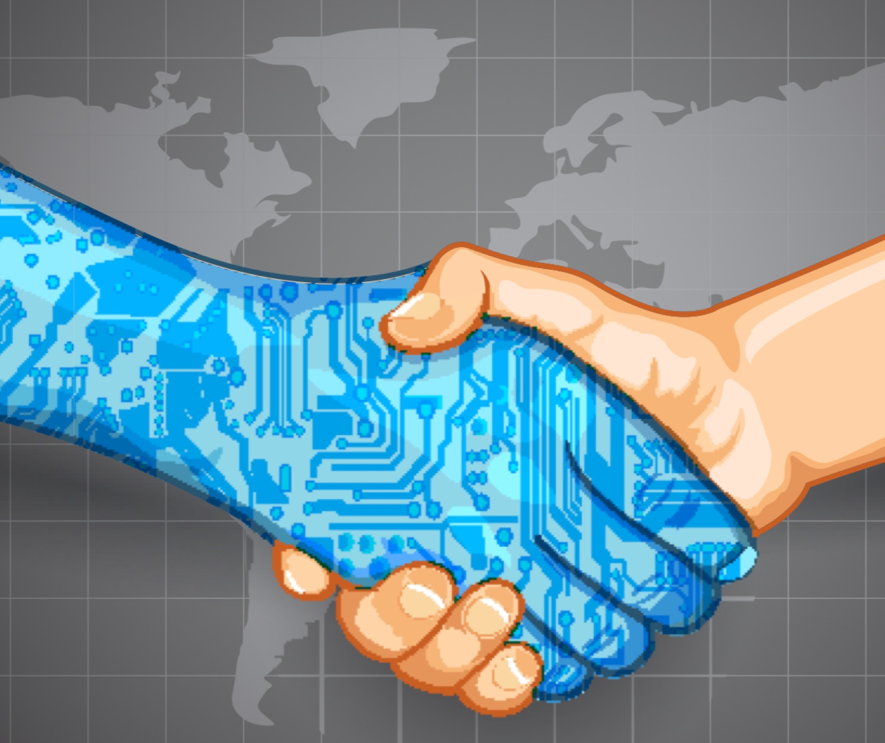
Smart Contract
What?
Business rules implied by the contract . .
. . embedded in the Blockchain &
executed with the transaction
Verifiable, signed
Encoded in programming language
Example:
Defines contractual conditions under which corporate Bond transfer occurs

Slide 13
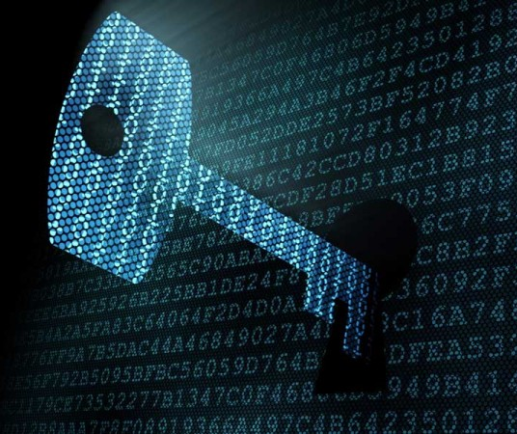
Privacy
What?
Ledger is shared, but participants require privacy
Participants need:
Transactions to be private
Identity not linked to a transaction
Transactions need to be authenticated
Cryptography central to these processes
Notes:
Not every member of business network can see all of the Blockchain
Cryptography controls who can see what
Implies user registration process to build trust network and access permission via certification management

Slide 14
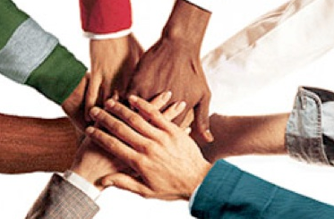
Consensus
What?
… the process by which transaction are verified
When participants are anonymous
Commitment is expensive
Bitcoin cryptographic mining provides verification for anonymous participants but at significant compute cost (proof of work)
When participants are known & trusted
Commitment possible at low cost
Multiple alternatives
proof of stake where fraudulent transactions cost validators (e.g. transaction bond)
multi-signature (e.g. 3 out of 5 participants agree)
PBFT (cross checked secure message exchange)
Industrial Blockchain needs “pluggable” consensus
Notes:
CRYPTOGRAPHIC consensus needed to support participant anonymity – this is NO TRUST system
This is expensive, giving a COST to anonymity.
When there is TRUST in a business network this become less, in the limit superfluous
So as TRUST increases then cost of consensus decreases or in the limit can be eliminated
Once participants identity

Slide 15
Contents
What
. . are Blockchain technologies ?
Why
. . is it relevant for our business?
How
. . can IBM help us apply Blockchain?

Slide 16



Blockchain Benefits
Why?
Saves
Removes
Reduces
Time
Cost
Risk
Transaction time from days to near instantaneous
Overheads and cost intermediaries
Tampering, fraud & cyber crime
Notes:
Other benefits include :
Improve discoverability
When everyone on an exchange can view the same ledger, it is easy to broadcast an intention (or offer) by appending it. For example, in a trading network, all asks and bids would be visible to every network participant.
Automate trusted processes
Unlike a centralized system where only the network operator can create a generalized solution that fits every user’s needs, Blockchain networks allow each participant to create customized solutions using their own proprietary business logic while running on the same common ledger.
Ensure trusted record-keeping
By design, no one party can modify, delete, or even append any record to the ledger without the consensus from others on the network, making the system useful for ensuring the immutability of contracts and other legal documents.

Slide 17
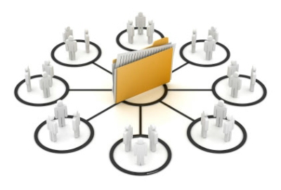
Consensus Use Case – Shared Routing Codes
What?
Competitors/collaborators in a business network need to share reference data, e.g. bank routing codes
Currently each member maintains their own codes, and forwards changes to a central authority for collection and distribution
How?
Each participant maintains their own codes within a blockchain network
Blockchain creates single view of entire dataset
Benefits
Consolidated, consistent dataset reduces errors
Near-real-time of reference data
Naturally supports code editing and routing code transfers between participants

Slide 18
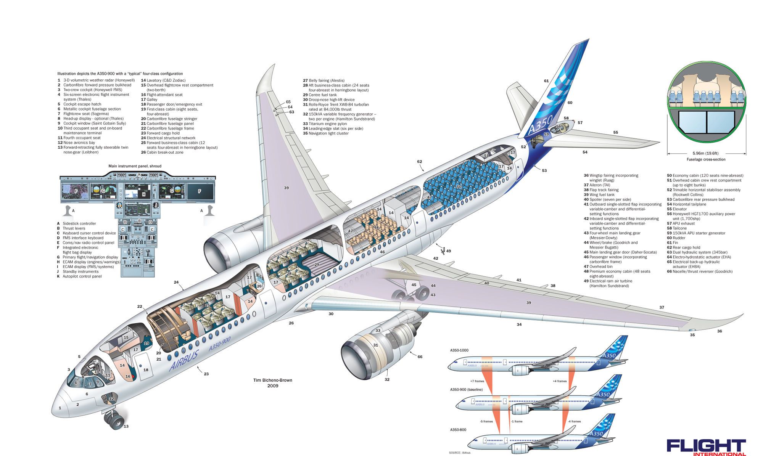
Provenance Use Case – Vehicle Maintenance
What?
Provenance of each component part in complex system hard to track
Manufacturer, production date, batch and even the manufacturing machine program
How?
Blockchain holds complete provenance details of each component part
Accessible by each manufacturer in the production process, the aircraft owners, maintainers and government regulators
Benefits
trust increased no authority "owns” provenance
improvement in system utilization
recalls "specific" rather than cross fleet

Slide 19

Immutability Use Case – Financial Ledger
What?
Financial data in a large organization dispersed throughout many divisions and geographies
Audit and Compliance needs indelible record of all key transactions over reporting period
How?
Blockchain collects transaction records from diverse set of financial systems
Append-only and tamperproof qualities create high confidence financial audit trail
Privacy features to ensure authorized user access
Benefits
Lowers cost of audit and regulatory compliance
Provides “seek and find” access to auditors and regulators
Changes nature of compliance from passive to active
@
@
$
#
#
{}
$
$
@
%
{}
£
£
$
%
!
+/-
£
£
£
€
€
27
£
!
$
@
{}
+/-
…

Slide 20
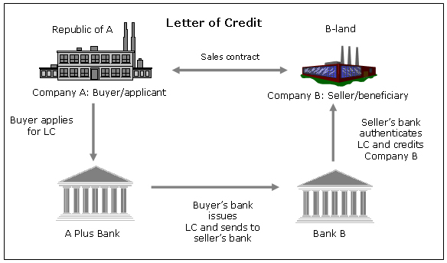
Finality Use Case – Letter of Credit
What?
Bank handling letters of credit (LOC) wants to offer them to a wider range of clients including startups
Currently constrained by costs & the time to execute
How?
Blockchain provides common ledger for letters of credit
Allows all counter-parties to have the same validated record of transaction and fulfillment
Benefits
Increase speed of execution (less than 1 day)
Vastly reduced cost
Reduced risk, e.g. currency fluctuations
Value added services; e.g. incremental payment

Slide 21
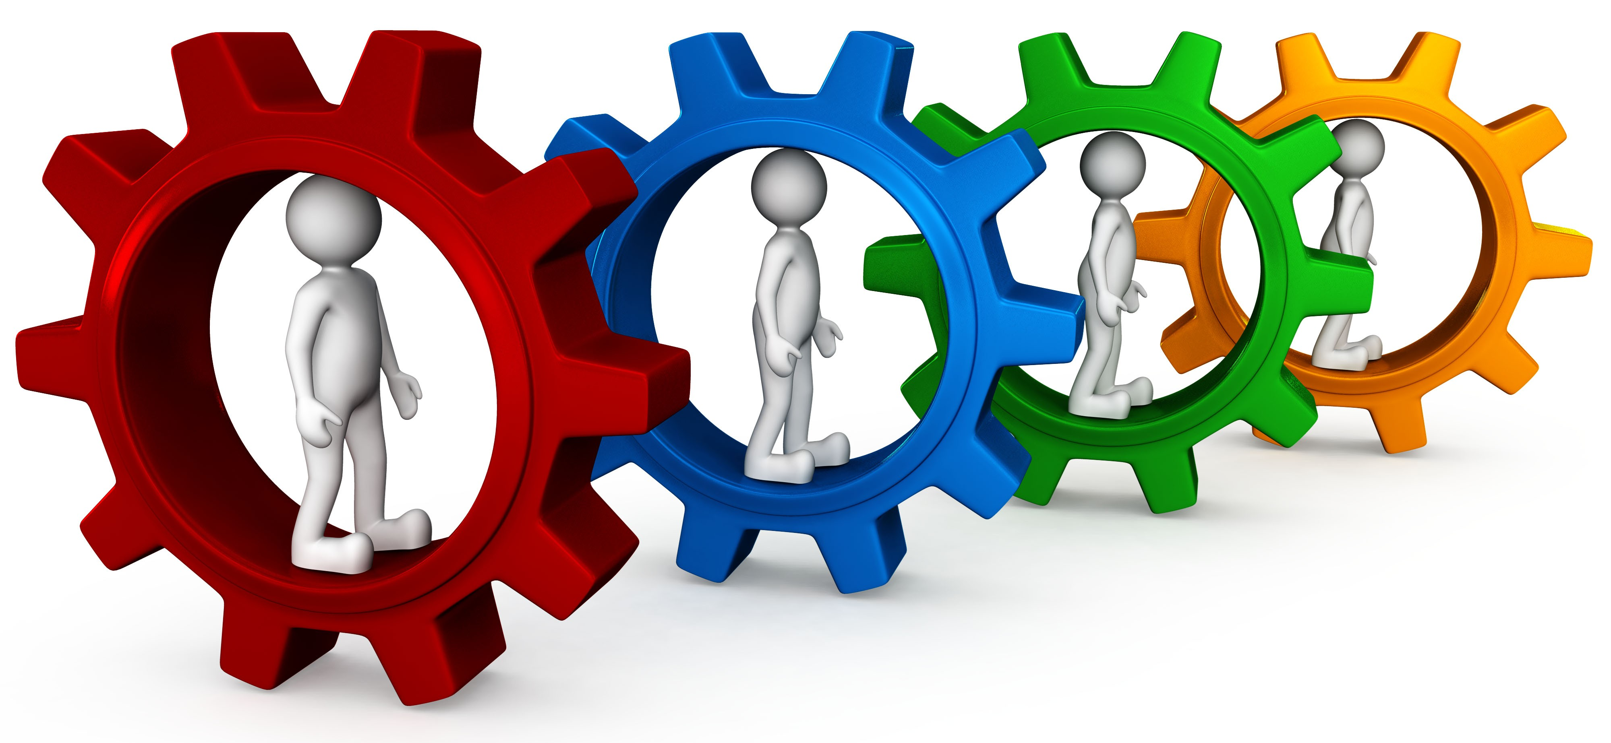
Other Potential Use Cases include . .
Why?
Securities
Post-trade settlement
Derivative contracts
Trade Finance
Bill of Lading
Cross-currency payment
Syndicated Loans
Supply Chain
Retail Banking
Cross border remittances
Mortgage verification & contracts
Public Records
Real estate records
Vehicle registrations
Citizen Identity
Digital Property Management

Slide 22
Patterns for Customer Adoption
How?
Transfer of high value financial assets
Between many participants in a market
Regulatory timeframes
HIGH VALUE MARKET
Sharing of assets (voting, dividend notification)
Assets are information, not financial
Provenance & finality are key
ASSET EXCHANGE
Created by a small set of participants
Share key reference data
Consolidated, consistent real-time view
CONSORTIUM SHARED LEDGER
Real-time view of compliance, audit & risk data
Provenance, immutability & finality are key
Transparent access to auditor & regulator
COMPLIANCE LEDGER

Slide 23
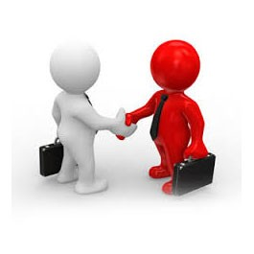
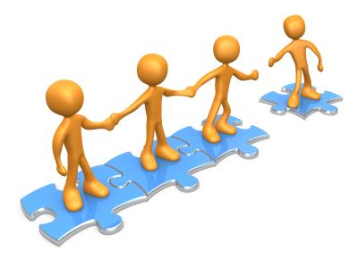
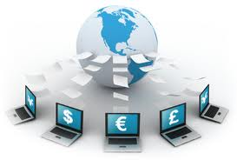
Key Players for Blockchain Adoption
Regulator
An organization who enforces the rules of play
Regulators are keen to support Blockchain based innovations
Concern is systemic risk – new technology, distributed data, security
Industry Group
Often funded by members of a business network
Provide technical advice on industry trends
Encourages best practice by making recommendations to members
Market Maker
In financial markets, takes buy-side and sell-side to provide liquidity
More generally, the organization who innovates
Creates a new good or service, and business process (likely)
Creates a new business process for an existing good or service

Slide 24


Not for all . . .
Why?
Blockchain is NOT
Suited to high performance (millisecond) transactions
For just one participant (no business network)
A replicated database replacement
A messaging solution
A transaction processing replacement
Suited for low value, high volume transactions
Notes:
Blockchain is not rights for all classes of business problem
This simple “indicators” chart helps us choose the right set of business problems

Slide 25
Contents
What
. . are Blockchain technologies ?
Why
. . is it relevant for our business?
How
. . can IBM help us apply Blockchain?

Slide 26
Hyperledger Project
How?
Linux Foundation - announced 17th December 2015
New Hyperledger project to transform the way business transactions are conducted around the world
Project members understand that an open source, collaborative development strategy supporting multiple players in multiple industries is required
Enable adoption of shared ledger technology at a pace and depth not achievable by any one company or industry
26

Slide 27
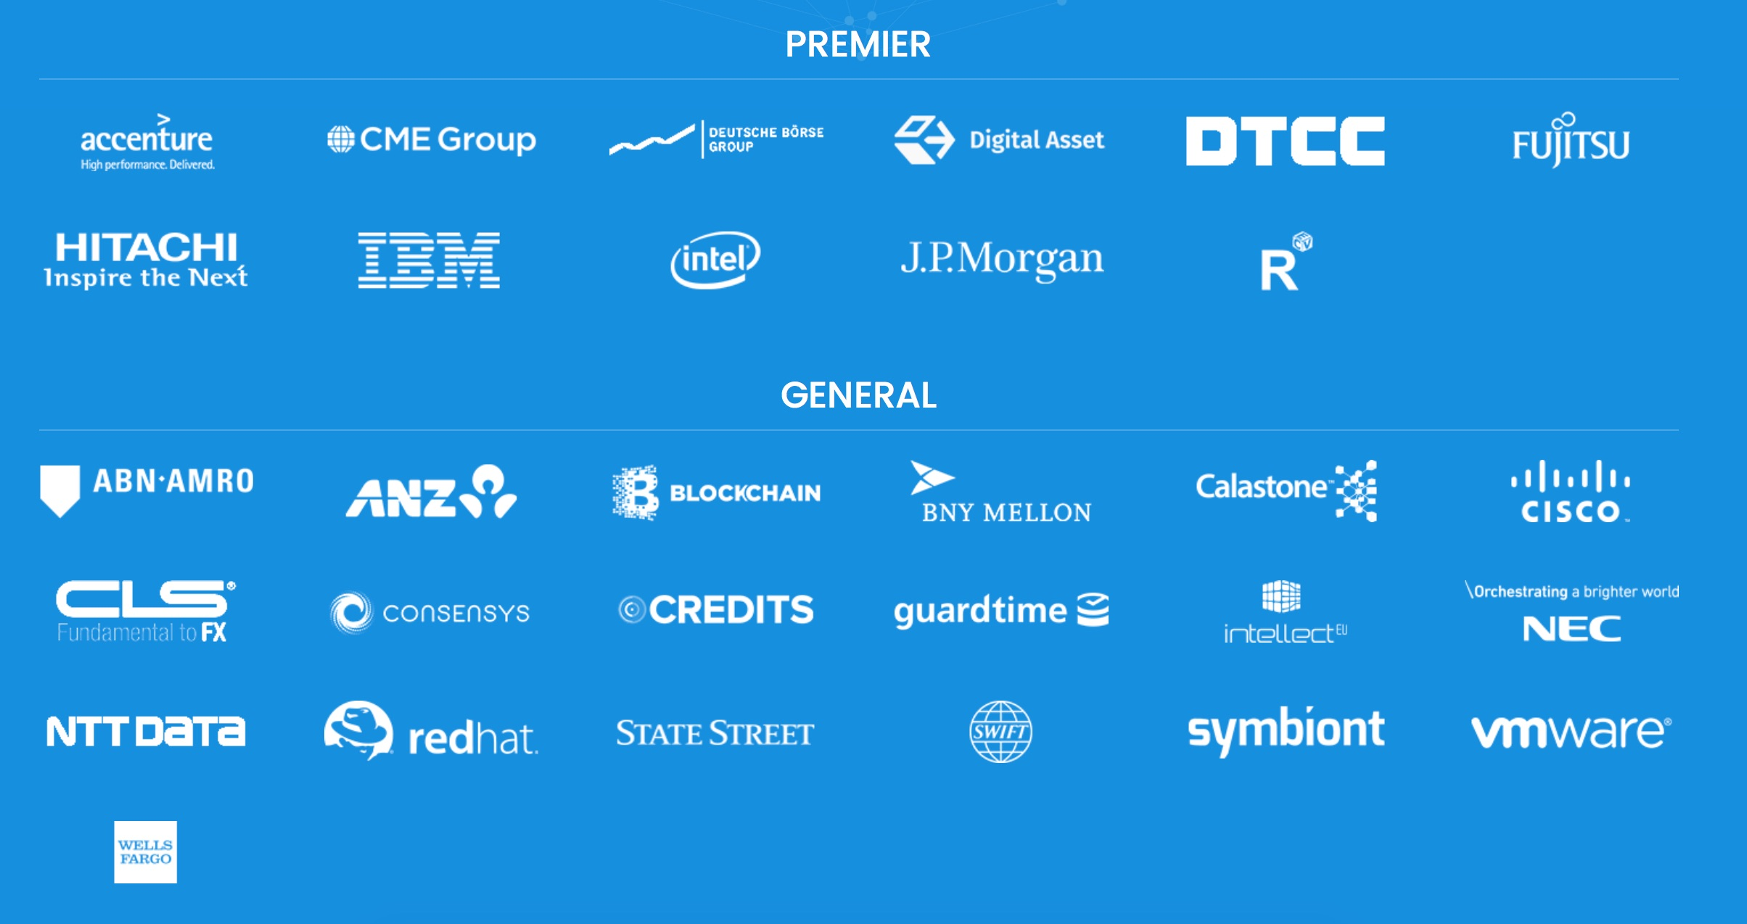
As of 15 Mar 2016

Slide 28

IBM Offerings Supporting Hyperledger
>
LINUX FOUNDATION
HYPERLEDGER
PROJECT
IBM Blockchain
ON IBM CLOUD
IBM Blockchain
SOLUTIONS
|
|
BLUEMIX SERVICE
Managed Service on IBM Cloud
Your private Blockchain network in 1-click
Learn with sample applications
Develop your own Smart Contracts
http://www.ibm.com/blockchain/
Blockchain

Slide 29

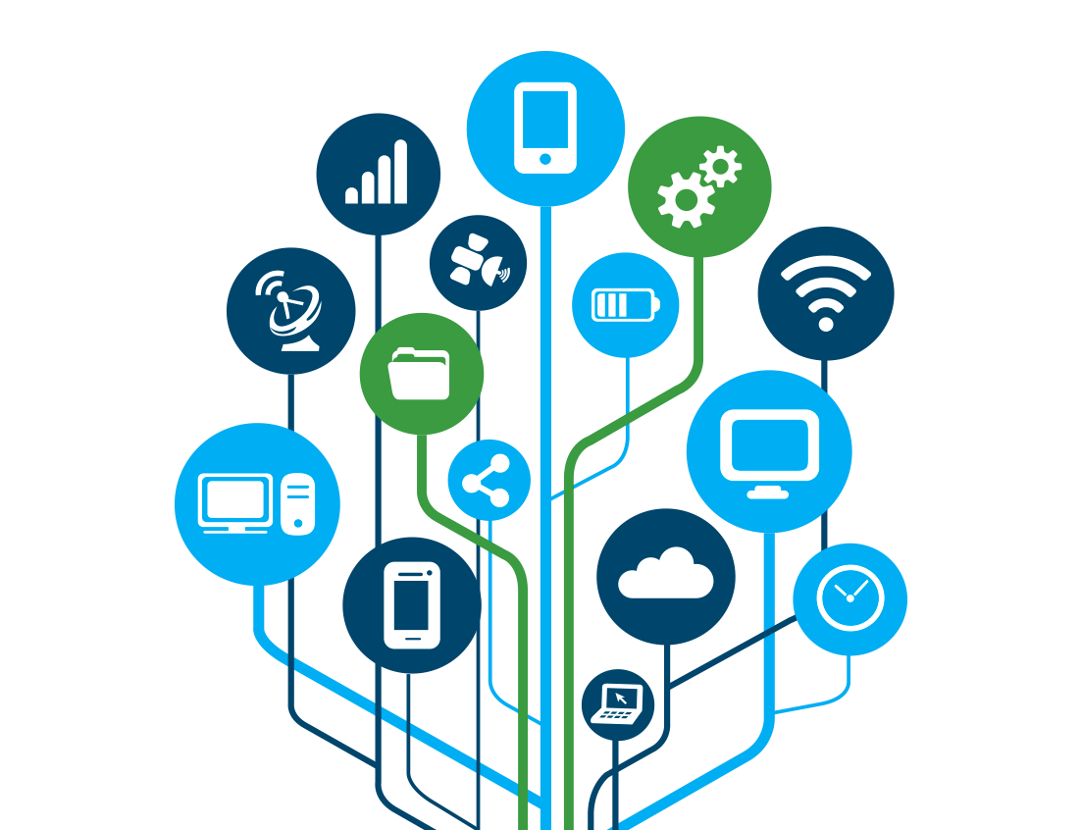


Engagement Model overview
How?
Let’s Talk!
Technology
Hands-on
First Project
Scale
Discuss Blockchain technology Explore customer business model Show Blockchain Application demo | Understand Blockchain concepts & elements Hands on with Blockchain technology Standard demo customization | Design Thinking workshop to define business challenge Agile iterations incrementally build project functionality Enterprise integration | Scale up pilot or Scale out to new projects Business Process Re-engineering Systems Integration
Remote or face to face | Remote or face to face | Face to face | Face to face
Free of charge | Free of charge | For fee | For fee

Slide 30

Summary
Blockchain is a shared, replicated, permissioned ledger technology
Blockchain can open up business networks by taking out cost, improving efficiencies and increase accessibility
Blockchain addresses an exciting and topical set of business challenges, which cross every industry
IBM supports the Linux Foundation Hyperledger open standard, open source, open governance Blockchain
IBM has an easy to access, proven and incremental engagement model giving customers the confidence to get started NOW

Slide 31
Thank You!

Slide 32
Backup

Slide 33


The Participants in a Blockchain Network
R
B2B transactions
U
Regulator
Blockchain
User
performs oversight
Blockchain
Certificate Authority
accesses security certificates
D
Blockchain Developer
creates applications
operates
access to data
Traditional Data Sources
O
Blockchain Network Operator
access to logic
Traditional Processing Platforms

Slide 34

Blockchain Components
Ledger
contains the current world state of the ledger and a Blockchain of transaction invocations
…
f(abc);
encapsulates business network transactions in code. transaction invocations result in gets and sets of ledger state
Smart Contract
Consensus
Network
a collection of network data and processing peers forming a Blockchain network. Responsible for maintaining a consistently replicated ledger
Membership
E
T
manages identity and transaction certificates, as well as other aspects of permissioned access
Events
creates notifications of significant operations on the Blockchain (e.g. a new block), as well as notifications related to smart contracts. Does not include event distribution.
Systems
Management
i
provides the ability to create, change and monitor Blockchain components
Wallet
securely manages a user’s security credentials
Systems Integration
responsible for integrating Blockchain bi-directionally with external systems. Not part of Blockchain, but used with it.

Slide 35
Blockchain Applications and the Ledger
Blockchain
developer
develops
Application
D
develops
invokes
accesses
Smart Contract
*
emits
each invoke recorded
event
gets/sets
emits
Ledger
World/Ledger state
block
block
block
block
…
txn
txn
txn
txn
Blockchain
* Smart Contract implemented using chain code

Slide 36
Permissioned Ledger Access
Certificate Authority
Blockchain User B
Blockchain User A
TkeyB
shares Tcert public key
U
Membership
Application
Ecert
Requests
certificates
1xEcert, NxTcert
(stored in wallet)
U
uses
uses
Tcert
invokes SC txn
(signed with TkeyA,
encrypted with TkeyA, TkeyB…)
Application
TkeyA
TkeyB
Enrollment certificates (Ecerts) and Transaction certificates (Tcerts) can only be linked by CA and user
Accesses ledger
TkeyB
sc
…
Smart contract
deployed on every validating peer
(signed with Ekey of origin,
encrypted with validators’ key)
Consensus Network

